Slide 1

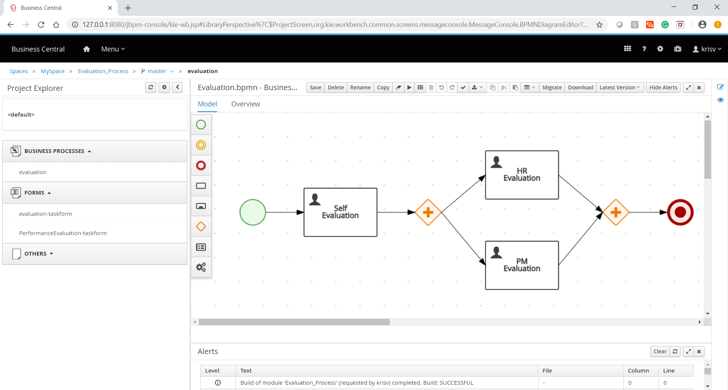
Working with the jBPM console
Notes:
Working with the jBPM console

Slide 2
Agenda
01
02
03
jBPM Components
Different elements
events
04
05
06
Tasks
Activities
Gateways
07
08
09
Data object, artifacts & swimlanes
Service tasks
Connecting objects

Slide 3
Agenda
10
11
12
Workbench
properties
QUIZ
13
14
conclusion
Hands-on

Slide 4
jBPM Components

Slide 5
Different Elements

Slide 6
Events
Start, Intermediate, End

Slide 7
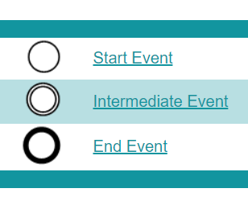

Events

Slide 8
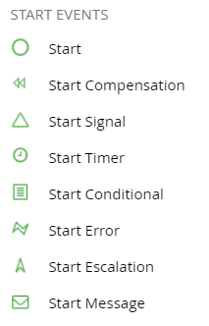
Start Event

Slide 9
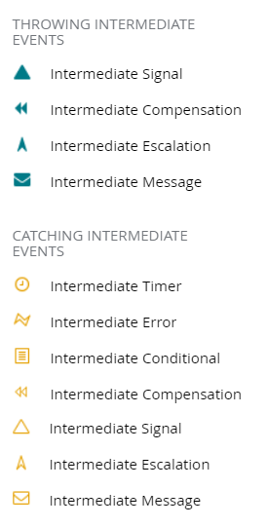
Intermediate Event

Slide 10
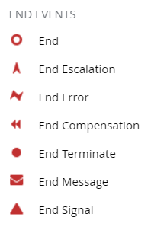
End Event

Slide 11
Activity
Tasks, Sub Process

Slide 12
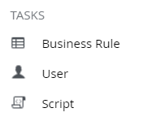
Task

Slide 13
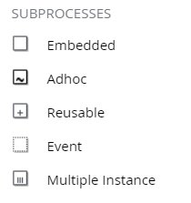
Sub Process

Slide 14
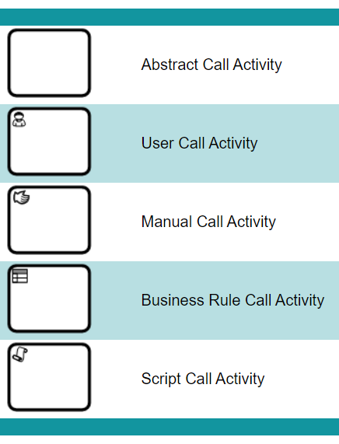
Call Activity

Slide 15
Gateway
Parallel, Exclusive, Inclusive

Slide 16
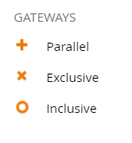
Gateway

Slide 17
Service Tasks
Service Tasks, Milestone, Decision Tasks

Slide 18
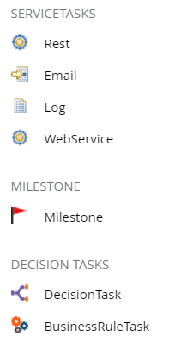
Service Tasks

Slide 19
Flow
Sequence, Message, Association, Data Association

Slide 20
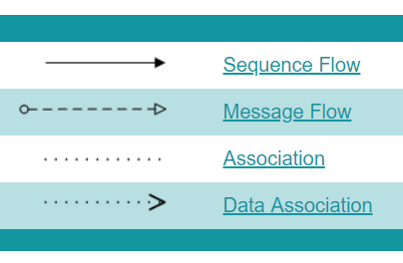
Flow

Slide 21
Data
Input, Output, Store

Slide 22
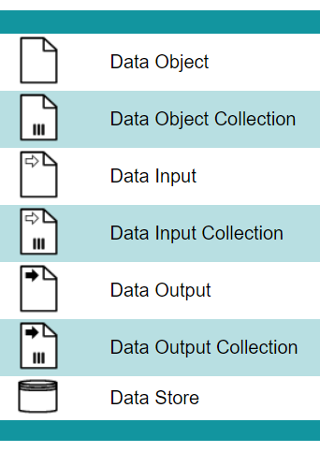
Data

Slide 23
Artifact
Group, Text Annotation

Slide 24
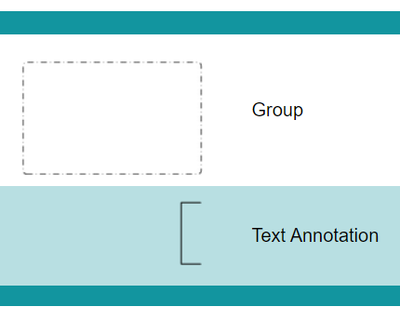
Artifact

Slide 25
Swimlane
Lane, Pool

Slide 26

Swimlane

Slide 27
jBPM Workbench

Slide 28
Properties

Slide 29

Quiz
Working with the jBPM Console

Slide 30
Quiz
By default jBPM-Console would be available at ______ port
8081
80
8080
9990

Slide 31

Answers
By default jBPM-Console would be available at ______ port
8081
80
8080
9990

Slide 32
Quiz
Service Tasks are Custom Workitem handlers
True
False

Slide 33
Answers
Service Tasks are Custom Workitem handlers
True
False

Slide 34
Conclusion

Slide 35


Summary
In this session, you have learnt:
jBPM Components
Different Elements
Events
Tasks
Activities
Gateways
Service Tasks
Connecting Objects
Data Objects, Artifacts & Swimlanes
Workbench
Properties

Slide 36
Hands-On
Practical

Slide 37
Hands-On 1
Create Processes based on Events, Activities and Subprocess.
Use all types of components and finish your exercise

Slide 38
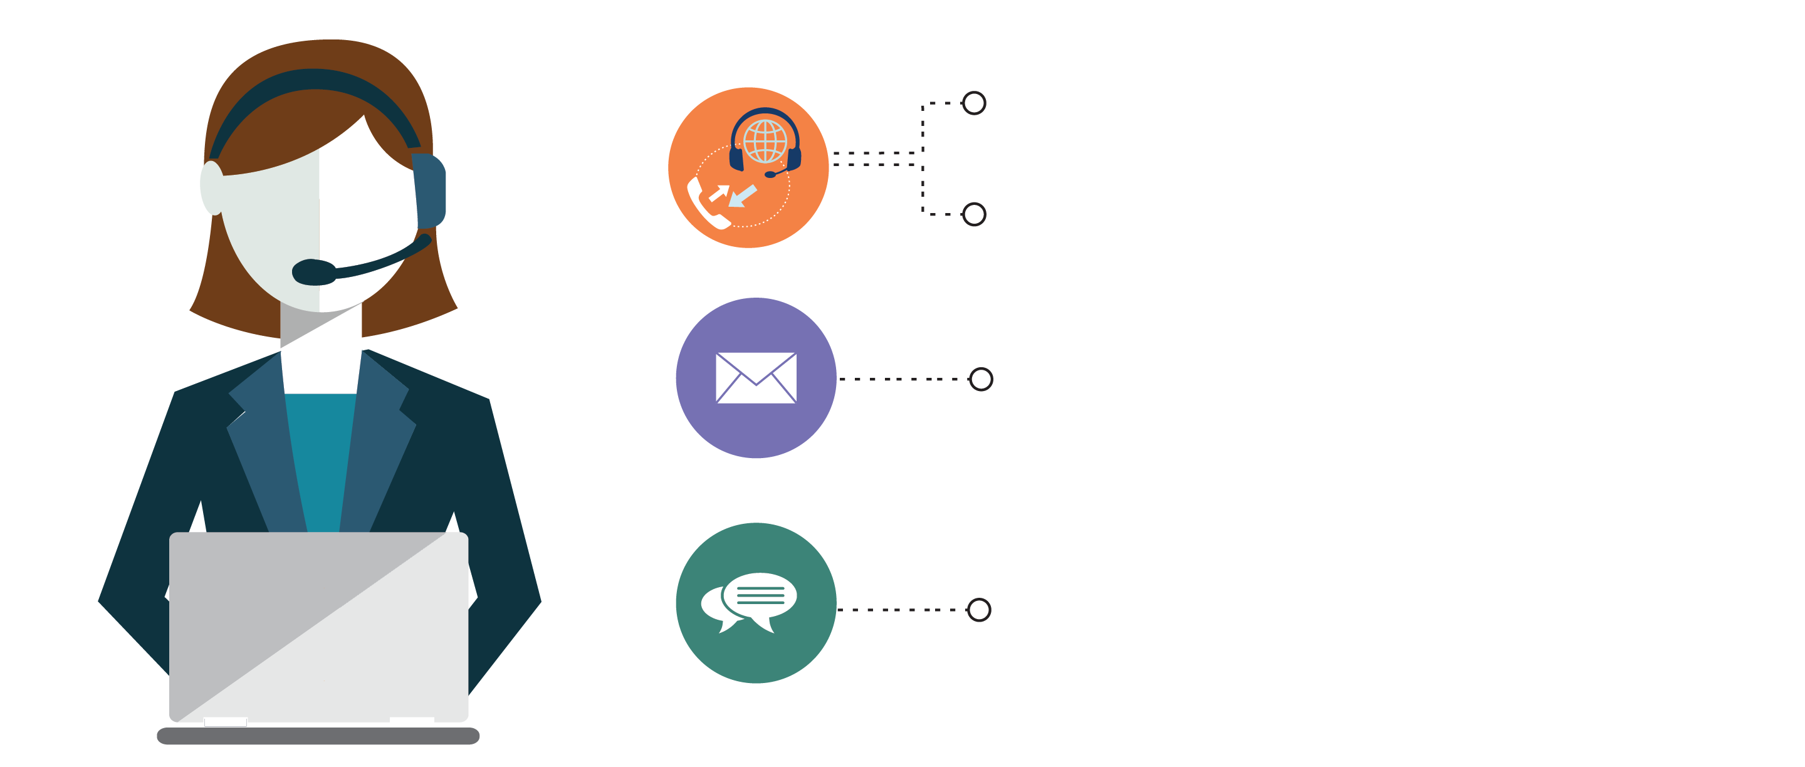
India : +91-7847955955
US : 1-800-216-8930 (TOLL FREE)
support@intellipaat.com
24X7 Chat with our Course Advisor
Notes:
Thank you!

